Slide 1
VITA Volunteer And Site Coordinator
Application Screen Shots

Slide 2
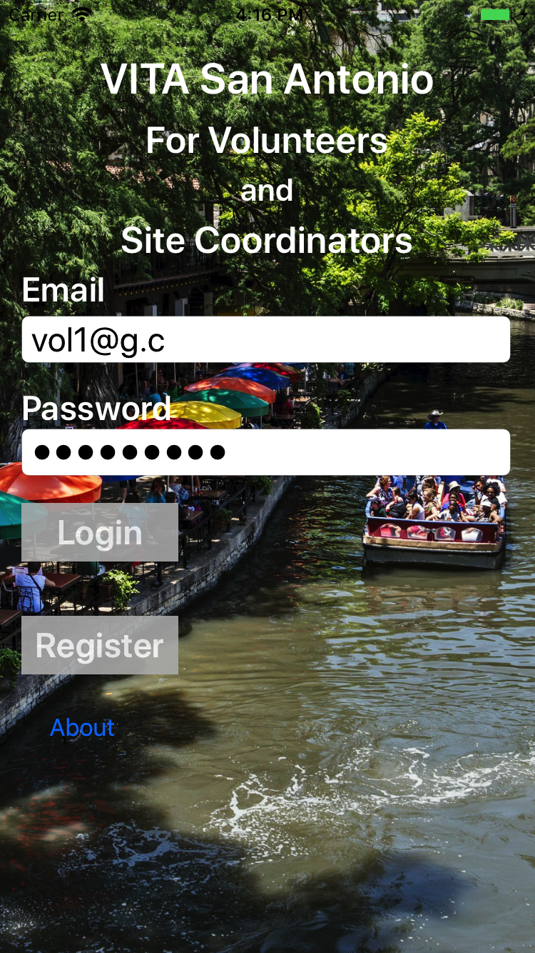
iOS/Apple Screen Shots

Slide 3
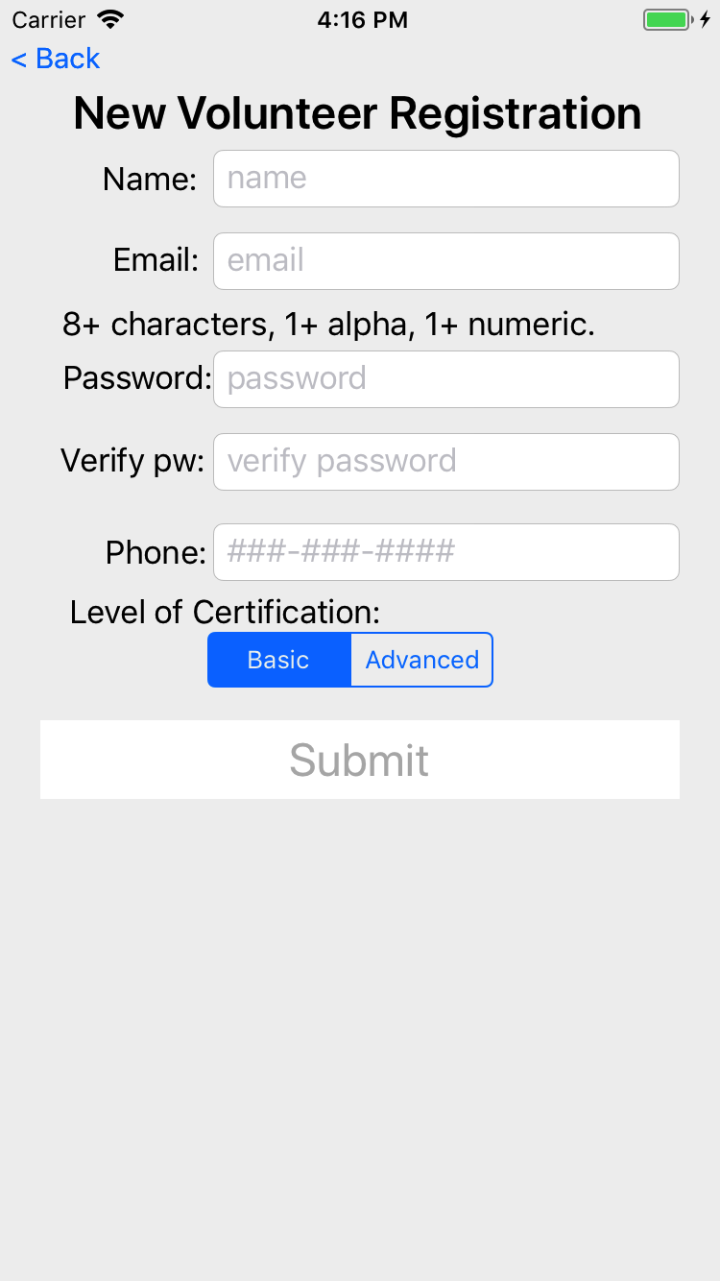
New volunteer registration
Once back office staff approves the user, they can login to the app.

Slide 4
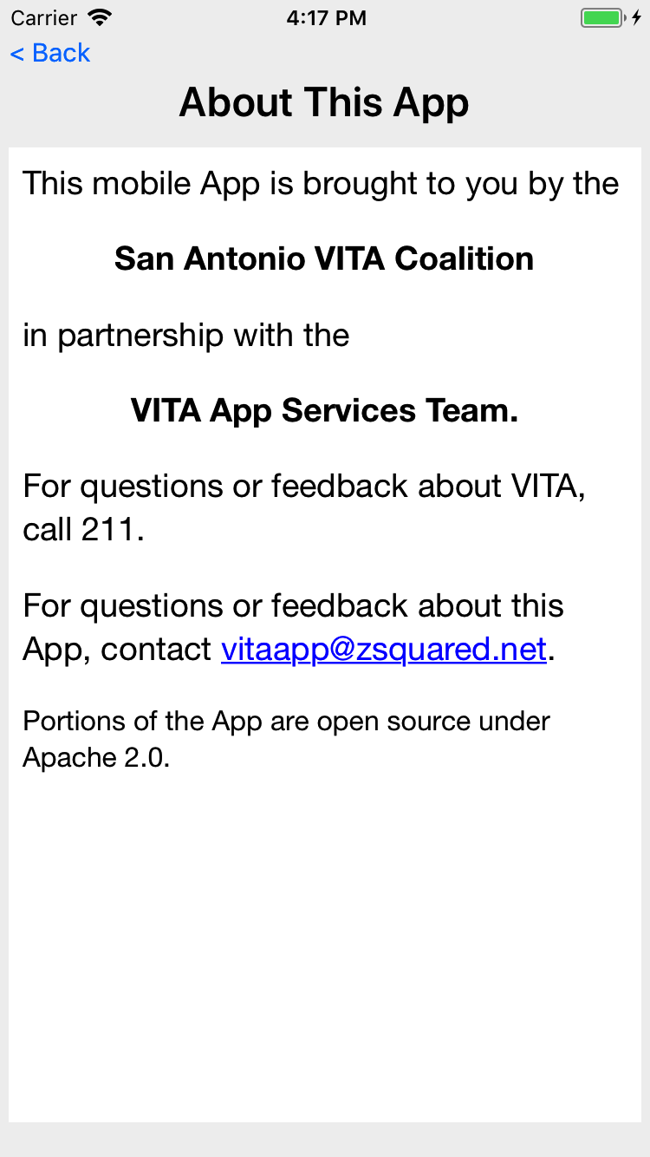
Information about the app.

Slide 5
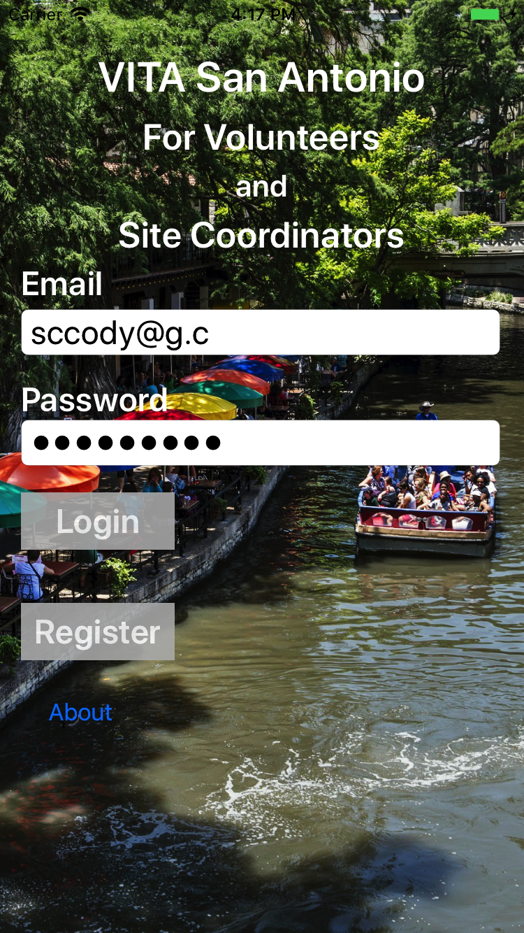
Site Coordinator login

Slide 6
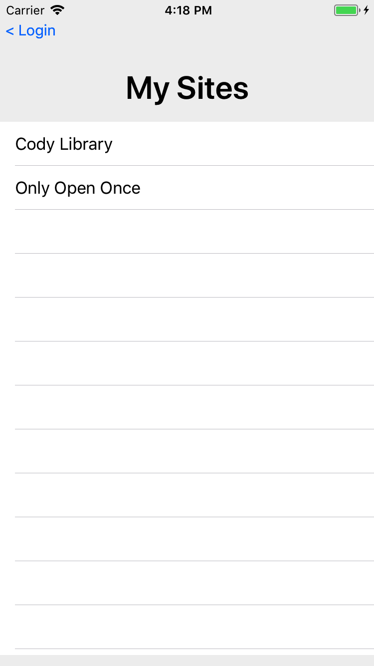
If a Site Coordinator is a primary or backup on more than one site, this screen is shown to determine which site they wish to manage.

Slide 7
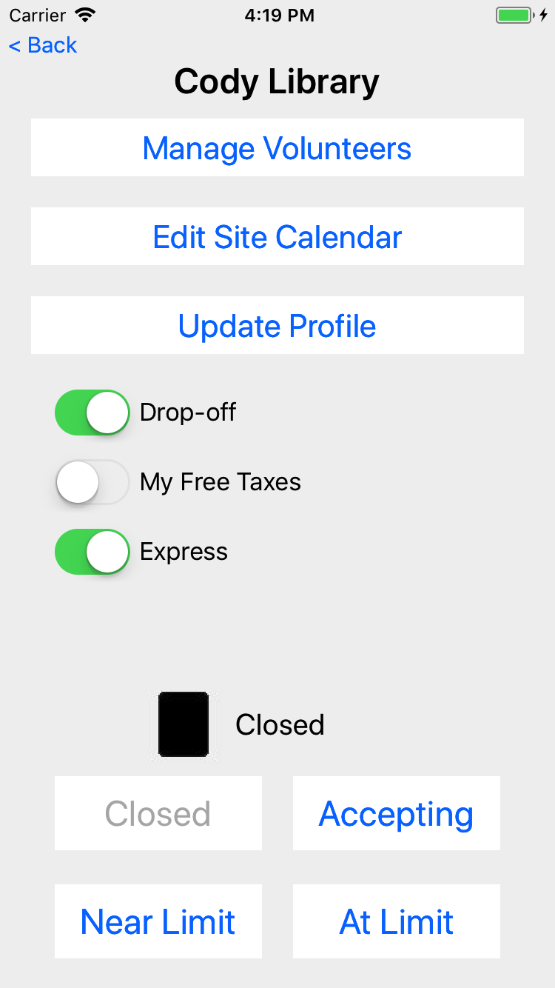
Managing the details for a Site

Slide 8
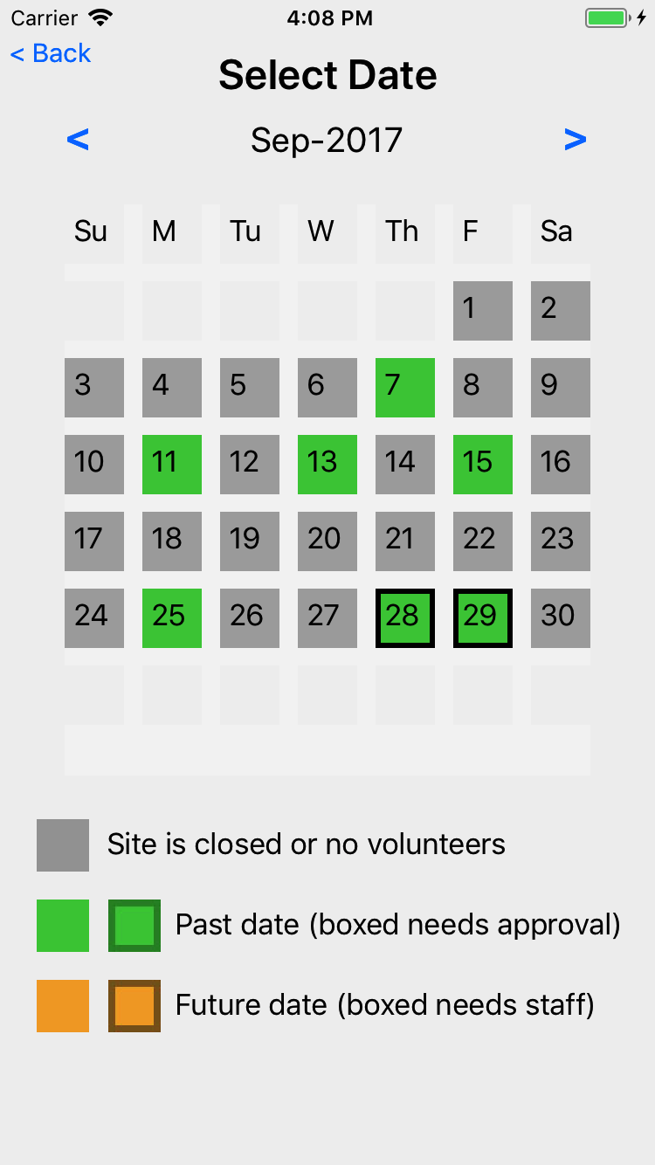
Get a view of volunteers at the site
This is the past dates, green for when volunteers worked, boxed for when their hours need approval

Slide 9
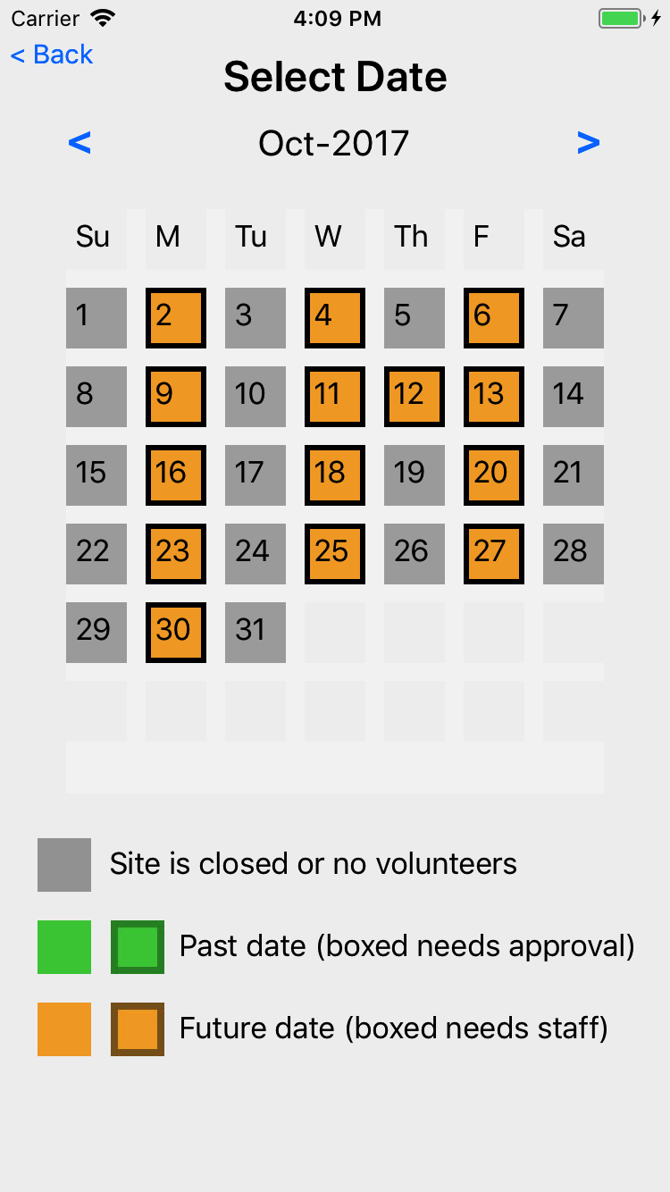
Get a view of volunteers at the site
This is the future dates, orange for when the site is open, boxed when the needed number of eFilers is less than the number signed up.

Slide 10
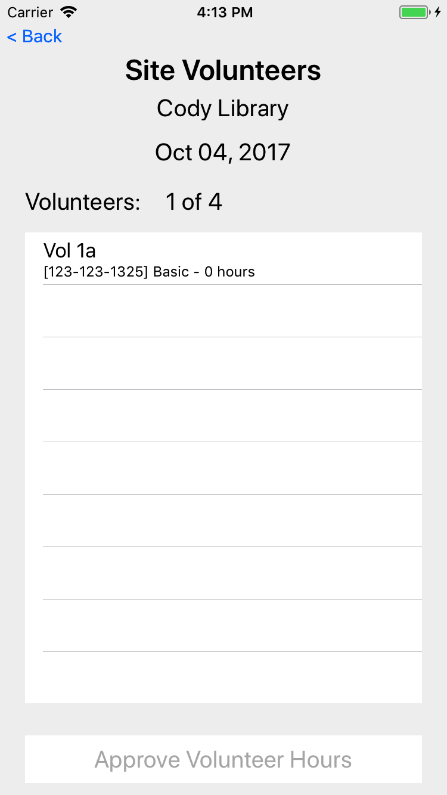
Manage Site Volunteers
See the volunteers for the date
See phone, cert level, and hours
SC can then approve hours for today and past dates

Slide 11
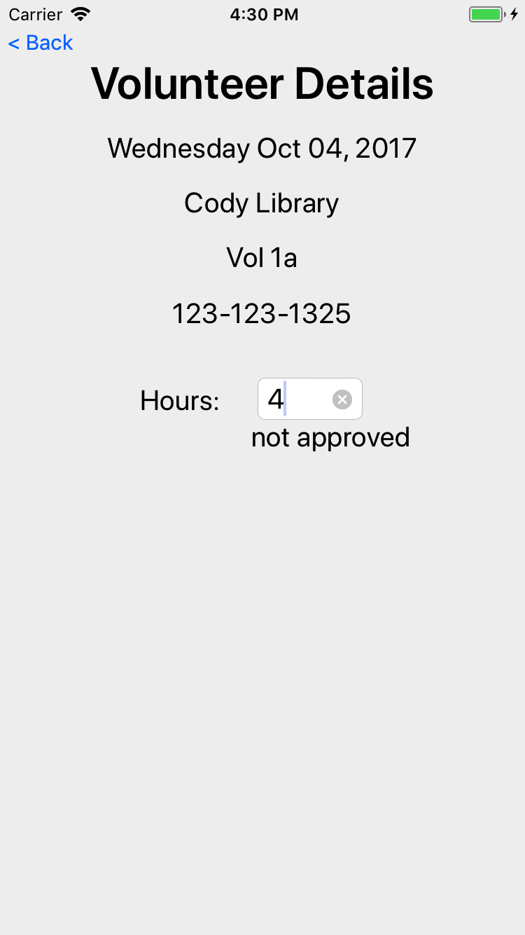
When a user is touched, the SC can adjust the hours (whether approved or not)

Slide 12
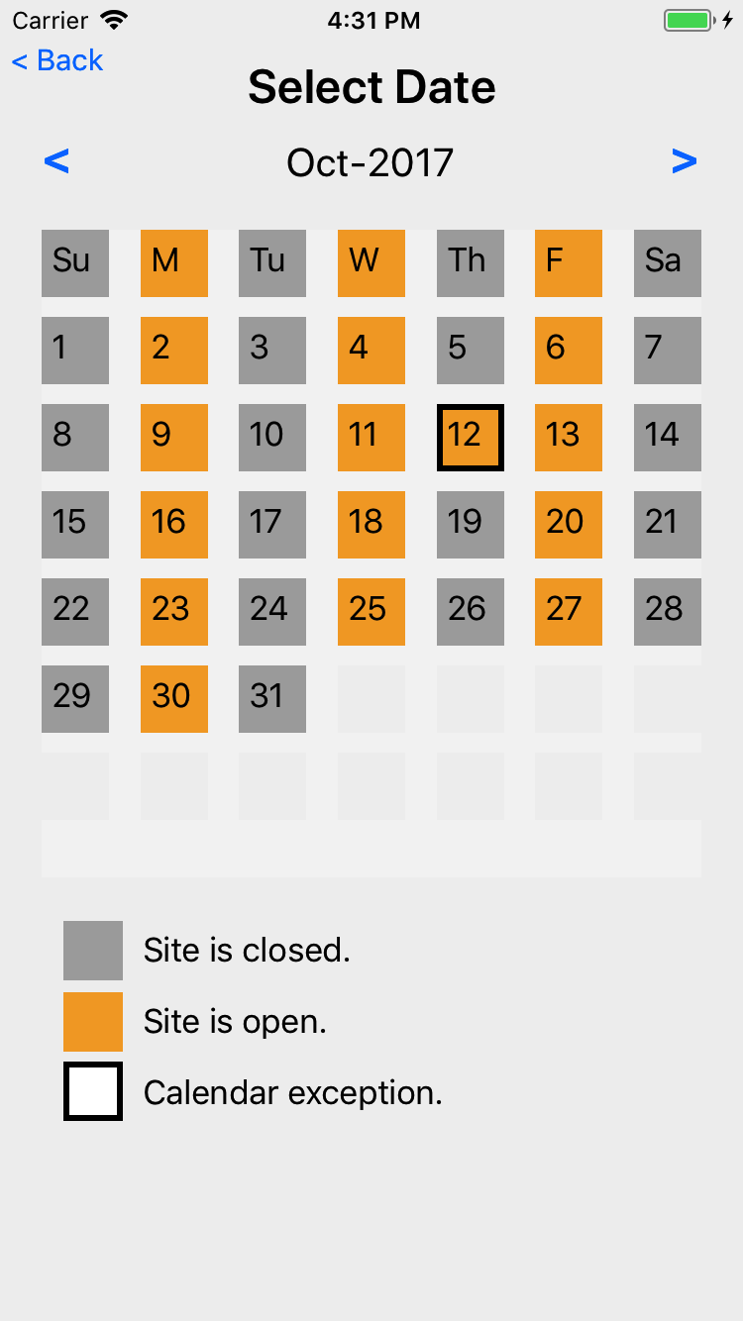
Edit Site Calendar
Touching on top row manages the defaults schedule for each day of the week
Touching a day of week allows edit/change/remove a calendar exception
The open/close for a Site is determined by starting with the defaults, then looking for an exception; if exception found, use the exception

Slide 13
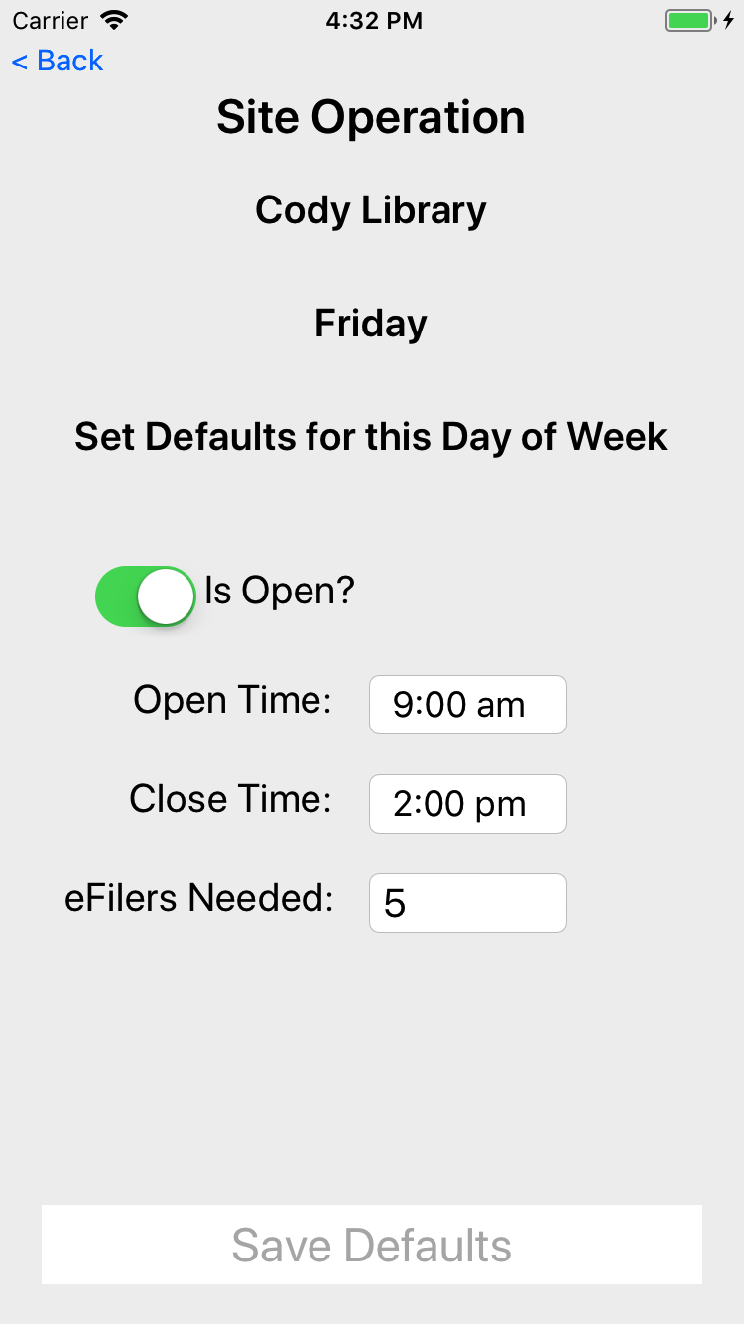
Edit site calendar defaults for each day of the week, Friday as shown here

Slide 14
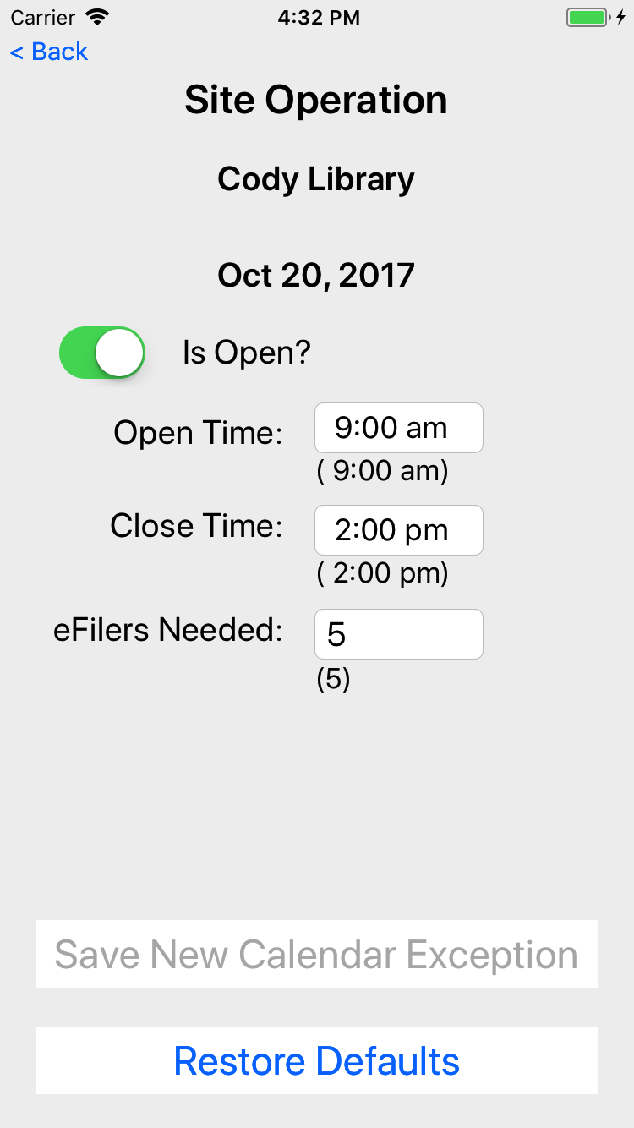
Screen to edit/remove an exception for a given date

Slide 15

Volunteer login

Slide 16
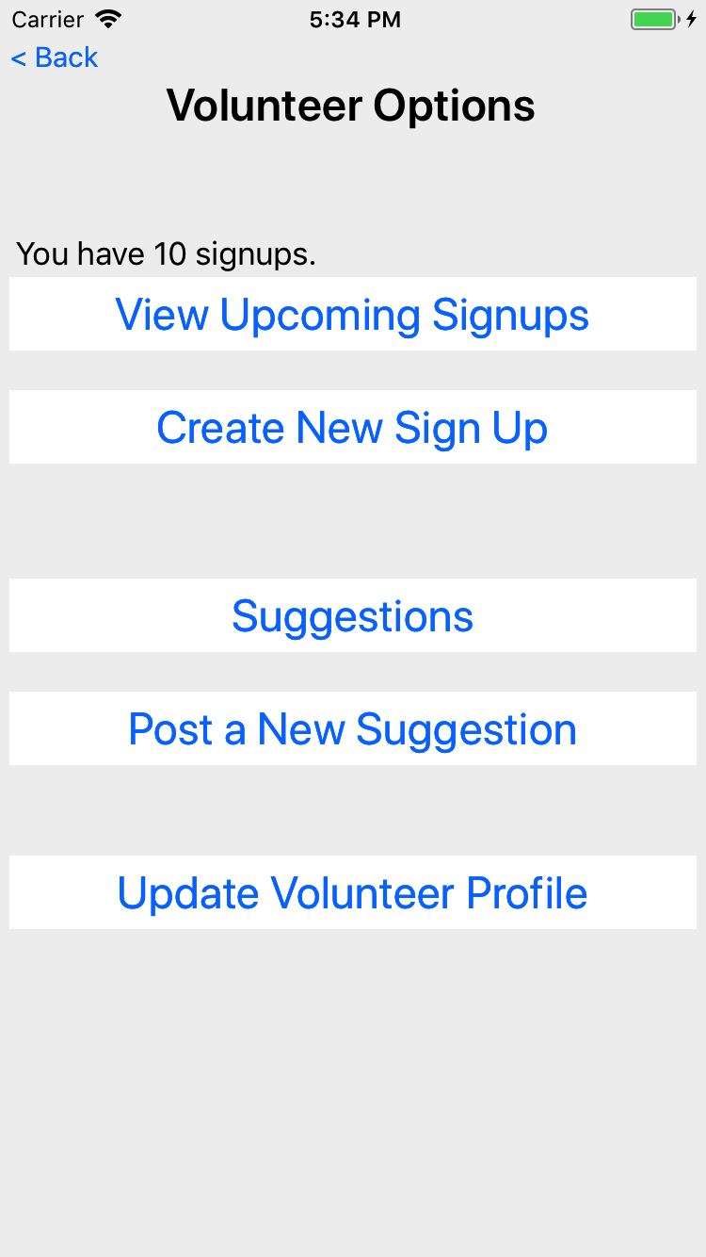
Volunteer options

Slide 17
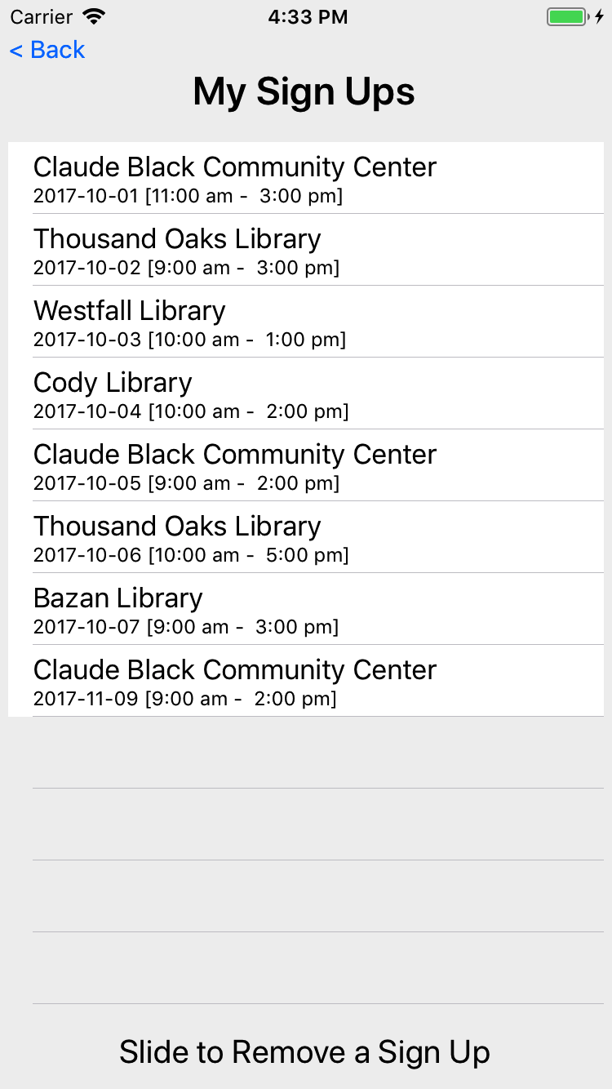
The list of signups for the volunteer, for today and moving forward.
Historical signups are not visible to the volunteer (only the site coordinator)

Slide 18
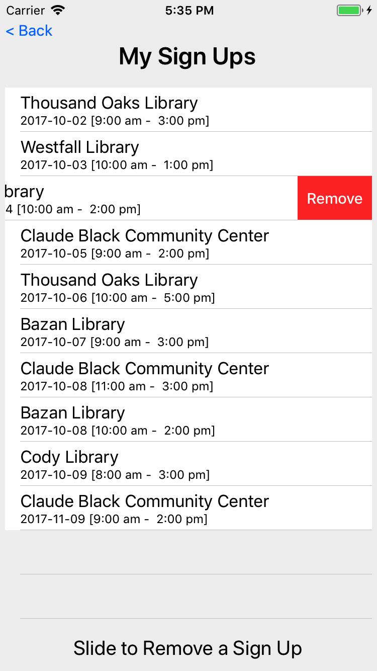

Slide 19
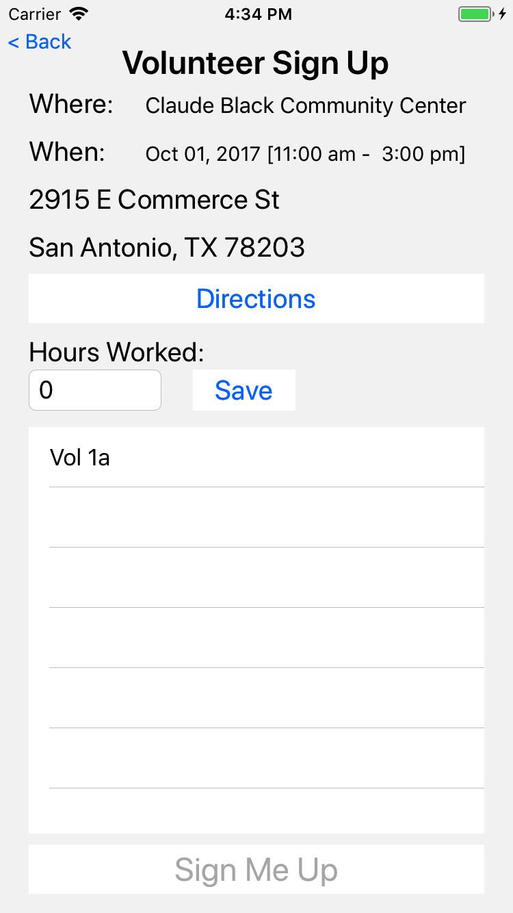
A volunteer can look a their signup, get directions to the site and adjust the hours work.
Hours work can be adjusted by the volunteer until approved by the SC.
The table at the bottom shows other volunteers at the same site on that date.

Slide 20
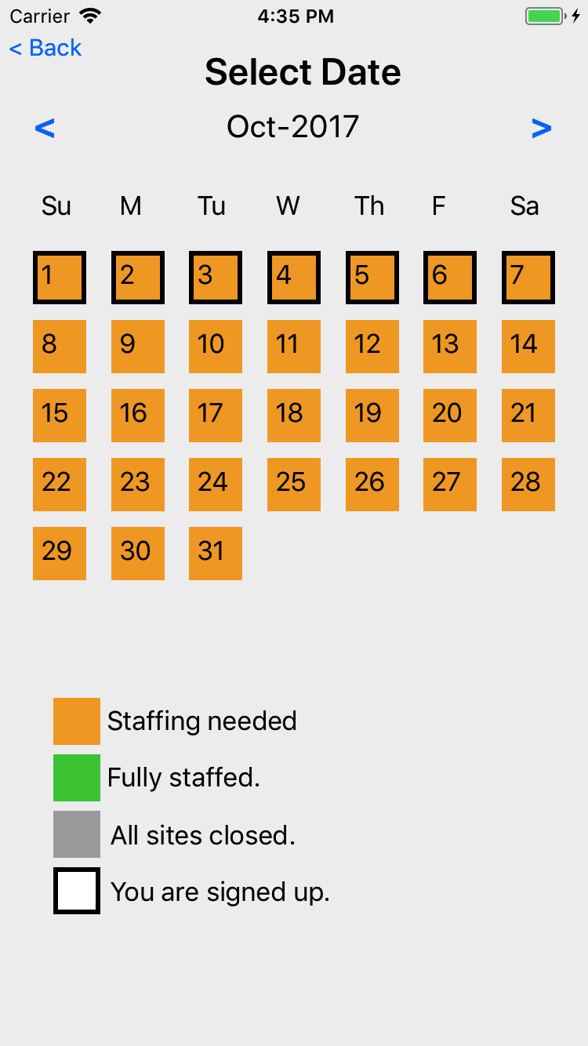
To create a new signup, a volunteer first picks a date.

Slide 21
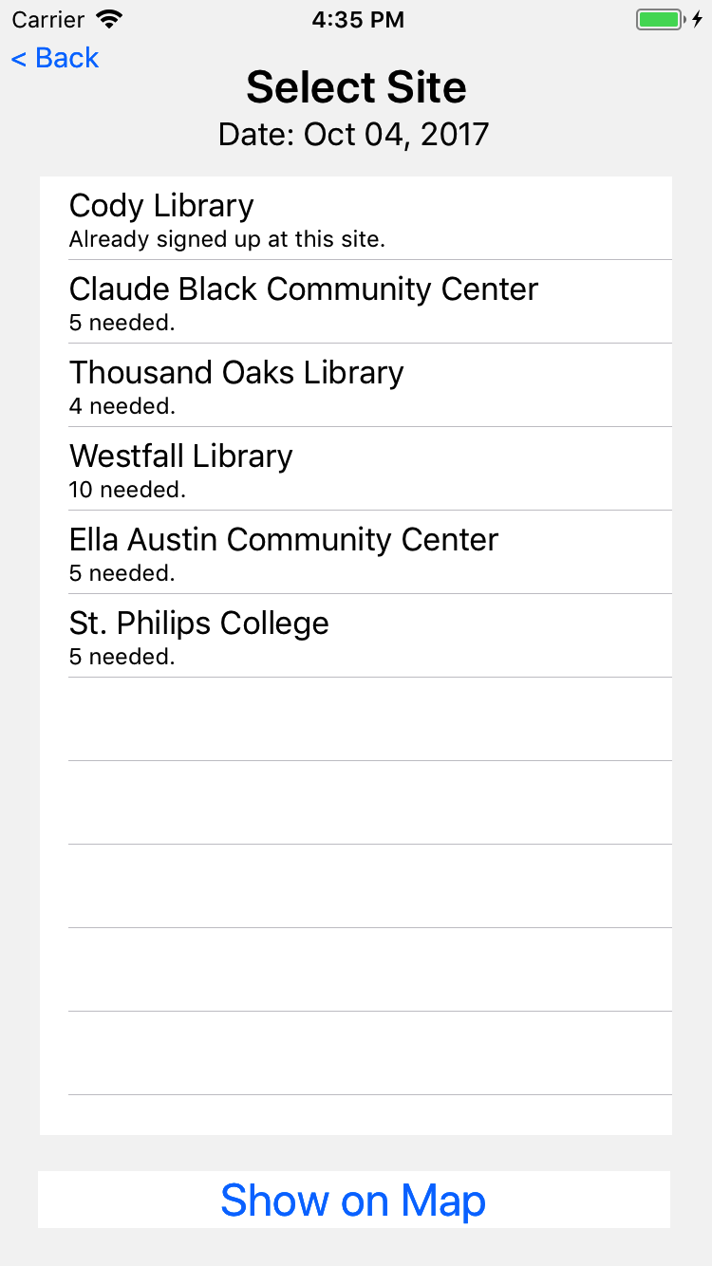
The app then shows sites open on that date that need 1 or more eFilers
If the user happens to be already signed up on that date, that site signup is show.
Mobile team members will be signed up on multiple sites per day.

Slide 22
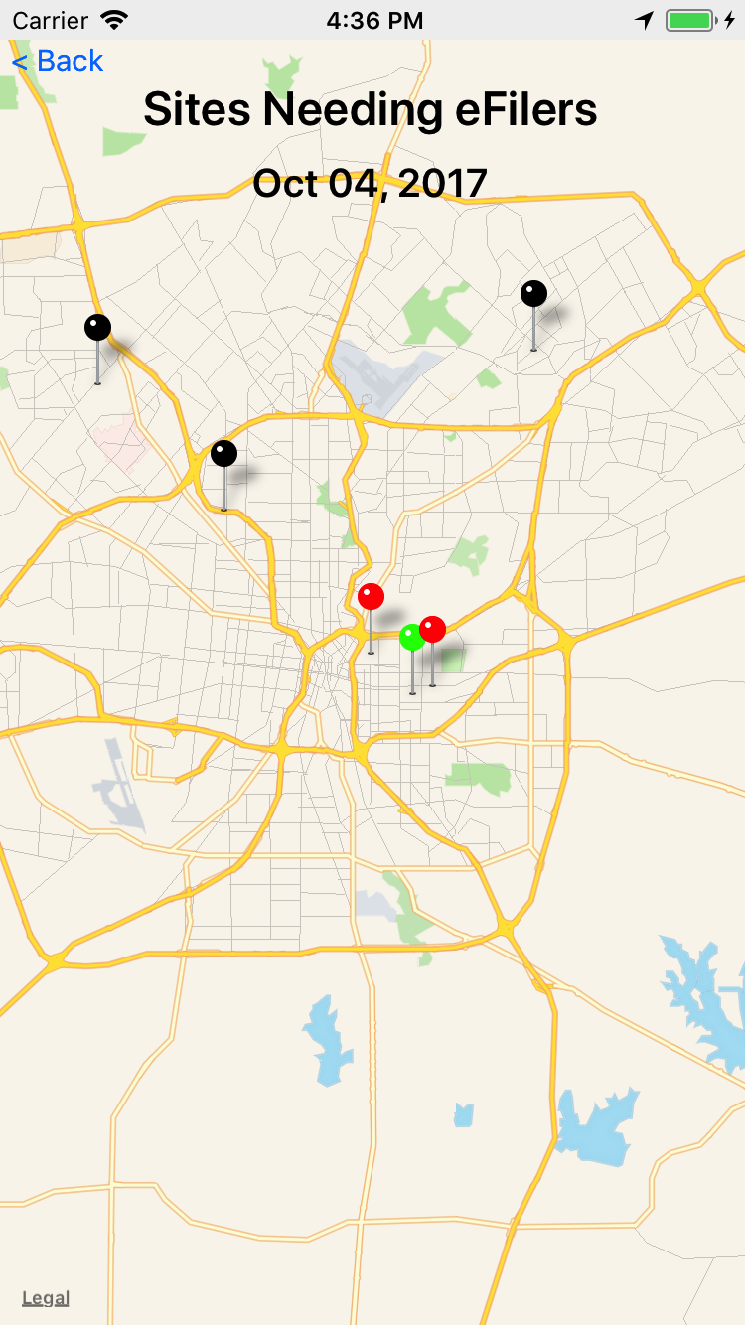
A map of sites needing eFilers
Black is a closed site
Green is a site that has all seats filled
Red is a site that needs help

Slide 23
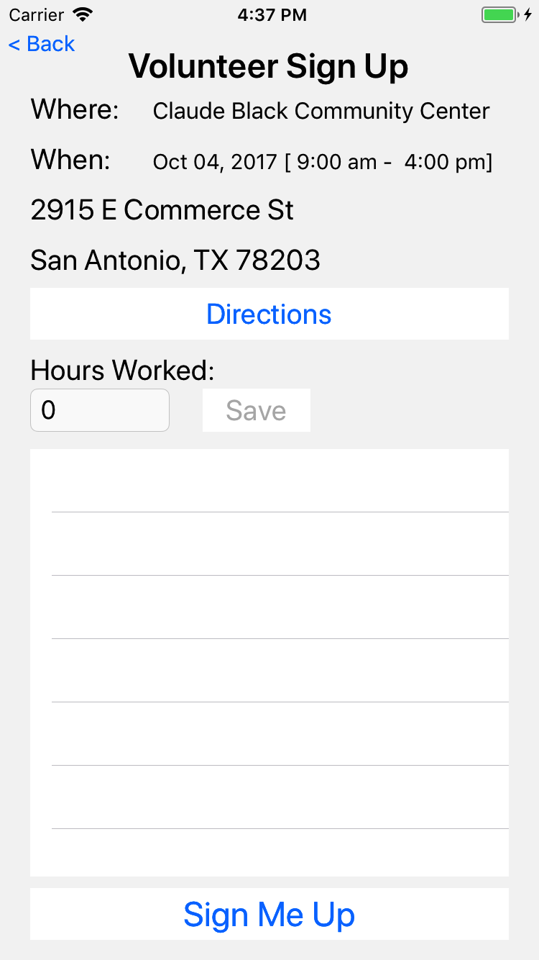
If the volunteer chooses a site, then they get a chance to sign up

Slide 24
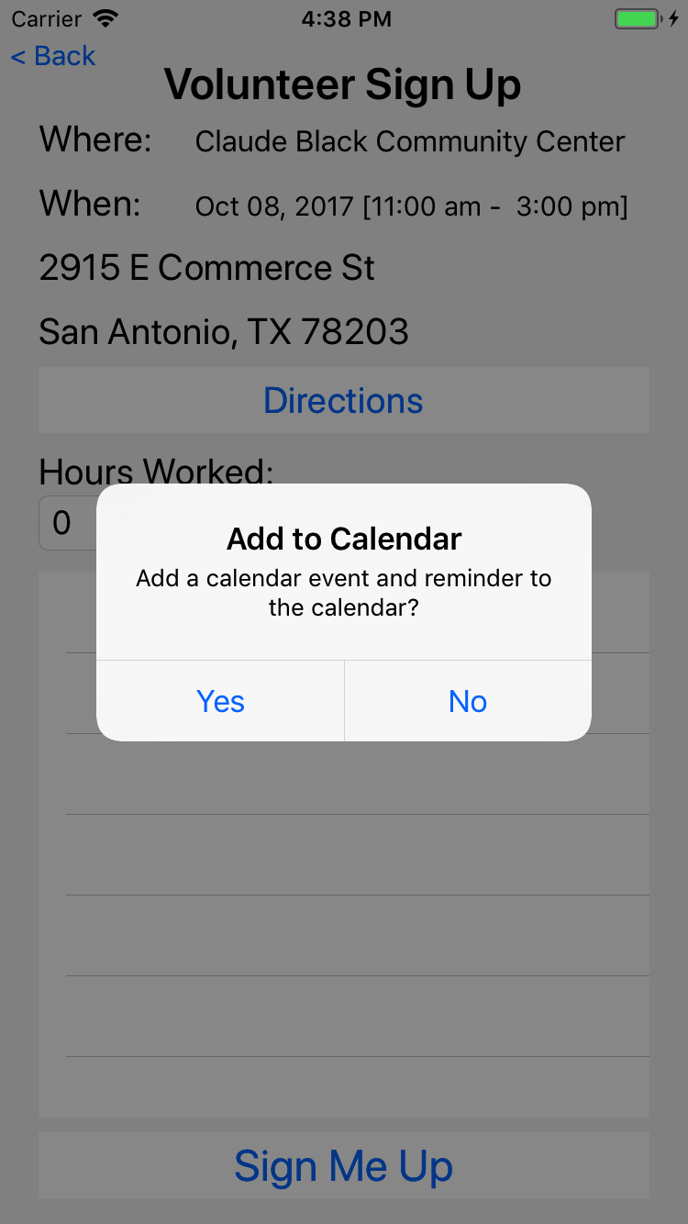
They are given an option to add to their default calendar

Slide 25
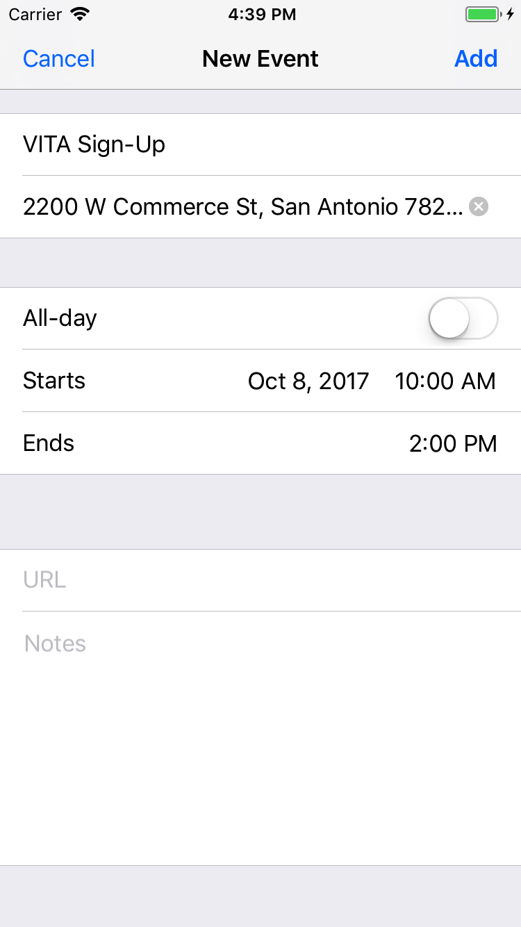
And the ability to modify the calendar event before it is saved in their calendar.

Slide 26
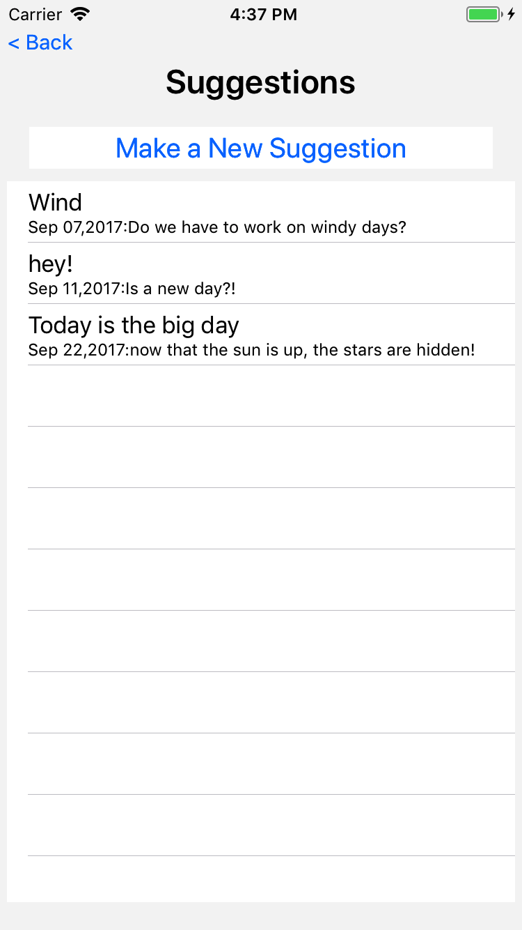
Volunteers can make suggestions.
Here is a list of suggestions from this user.

Slide 27
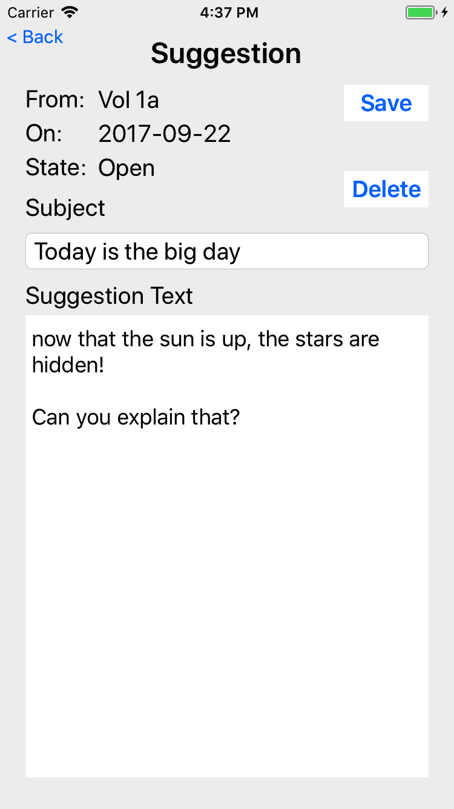
Touching a suggestion allows the user (that submitted the suggestion) to view
The user can make changes until the suggestion is read by the committee; after that, the user can only view the suggestion

Slide 28
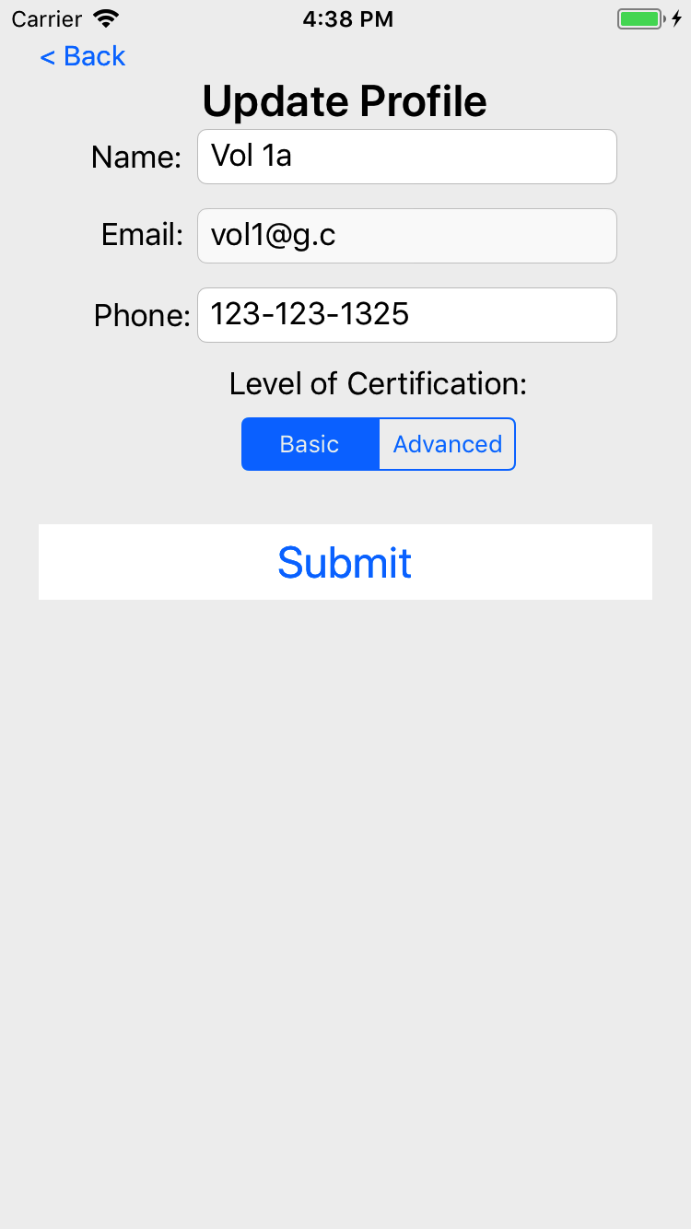
The volunteer can edit their name, phone, and certification but not their email

Slide 29
Android Screen Shots

Slide 30
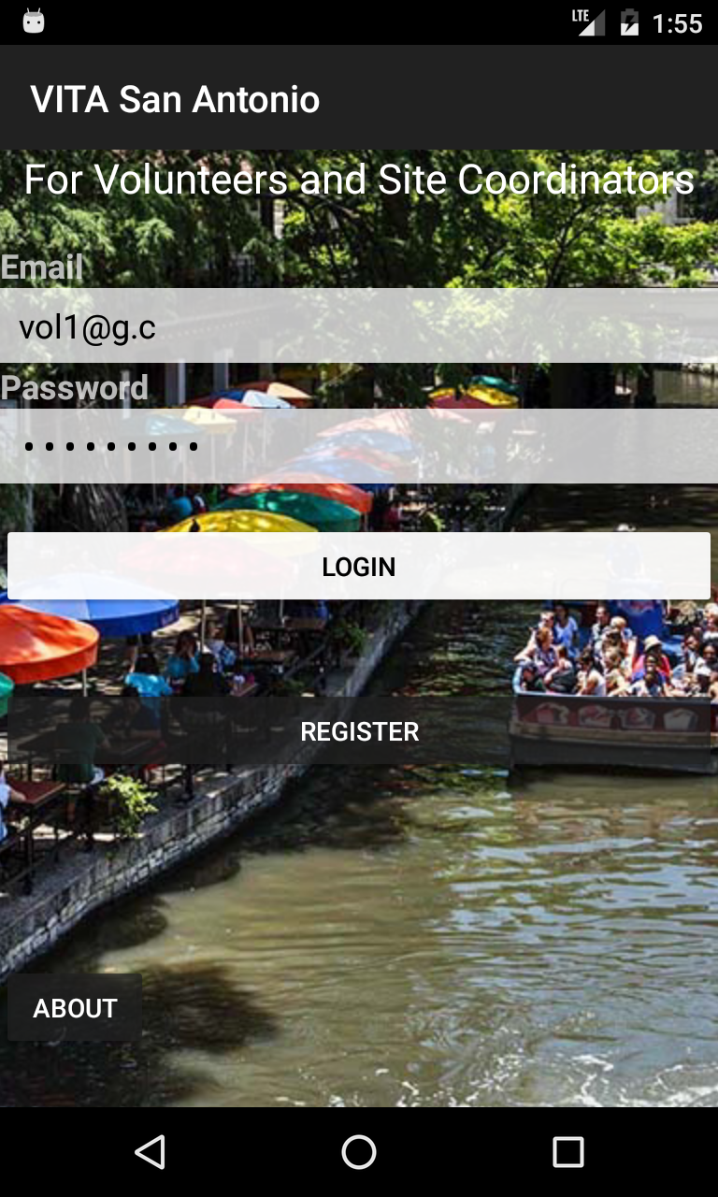

Slide 31
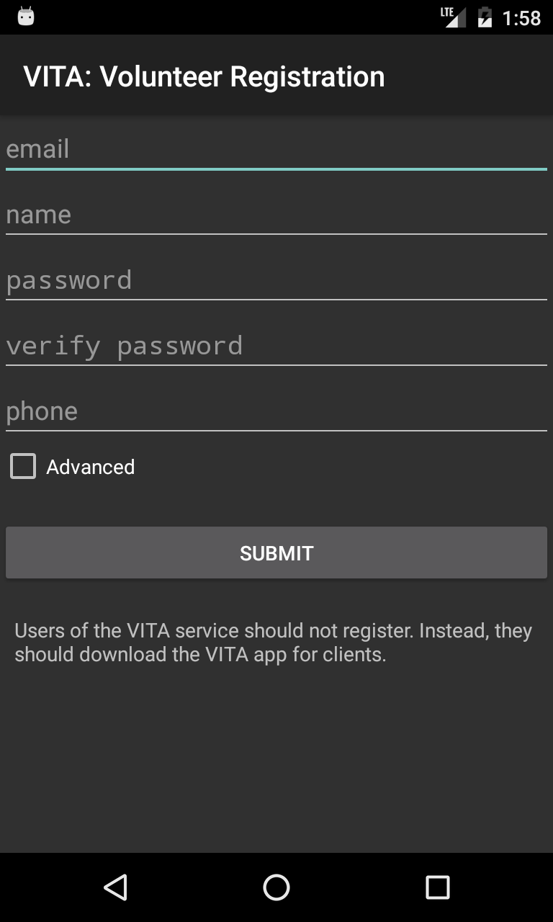

Slide 32
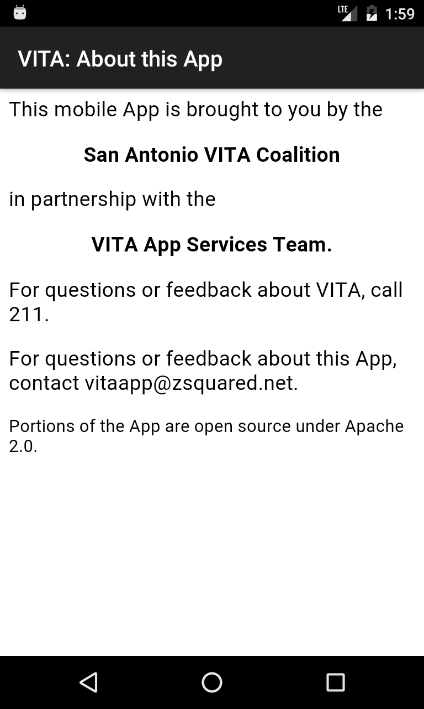

Slide 33
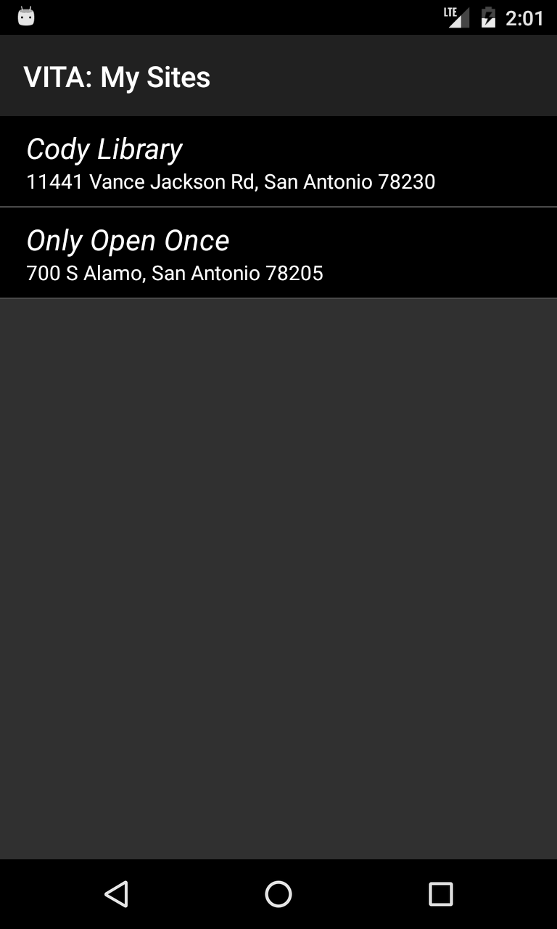

Slide 34
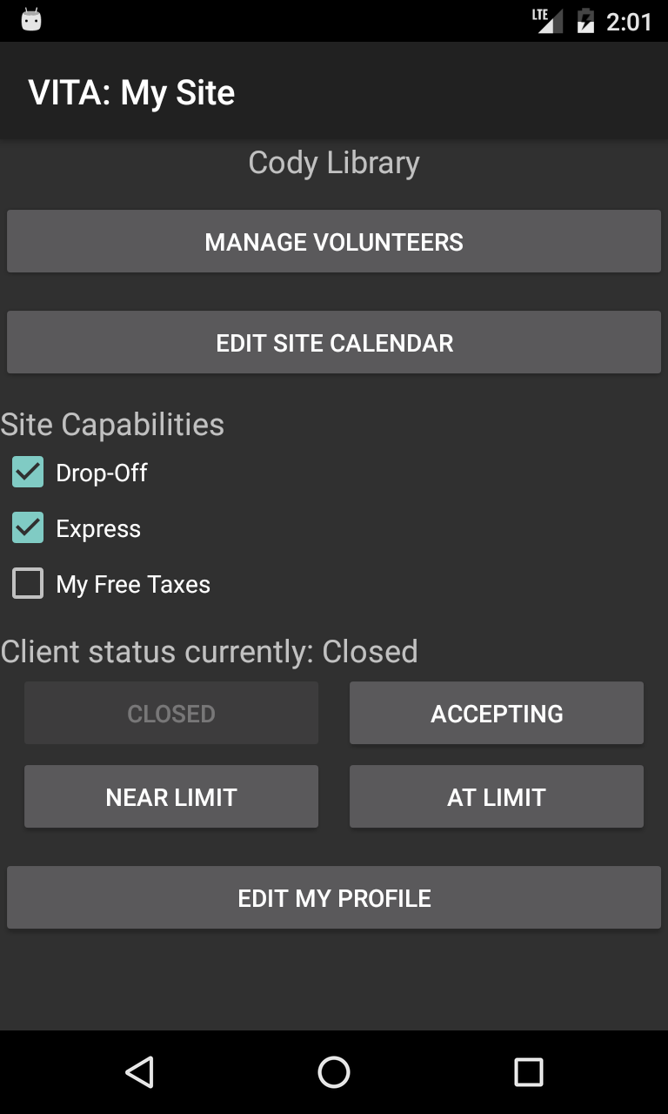

Slide 35
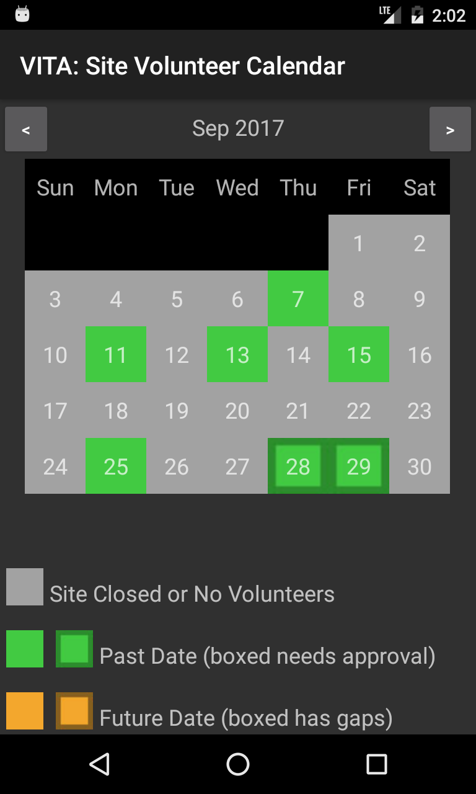
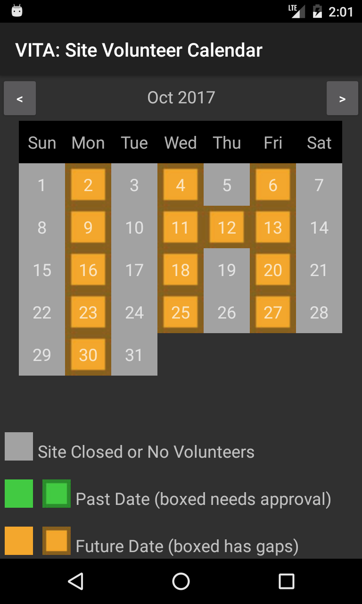

Slide 36
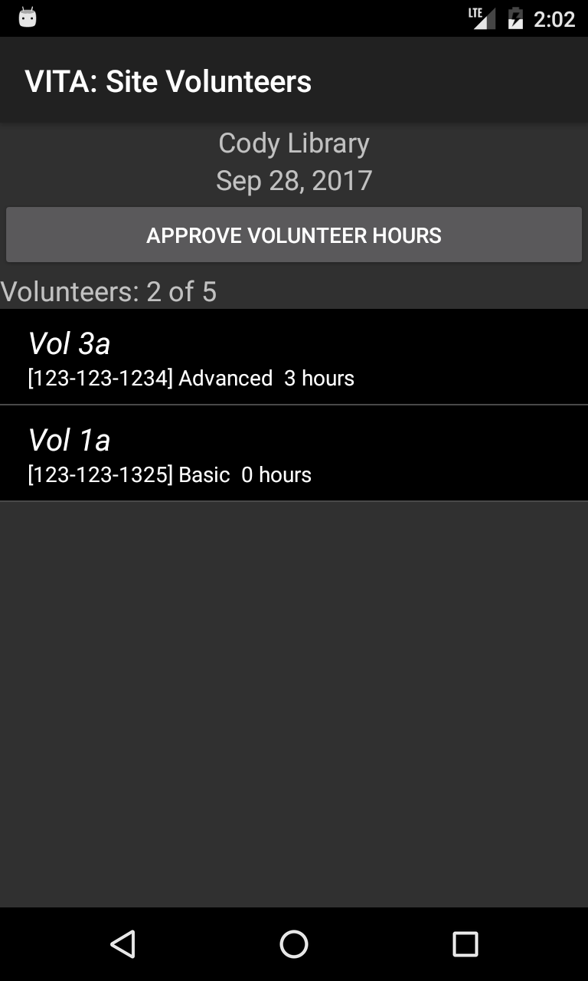

Slide 37
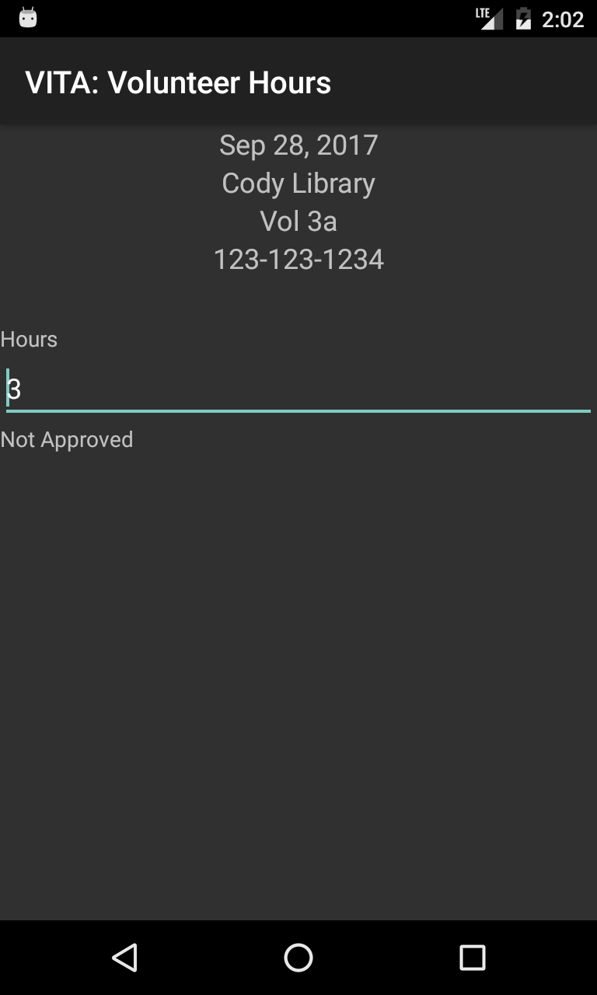

Slide 38
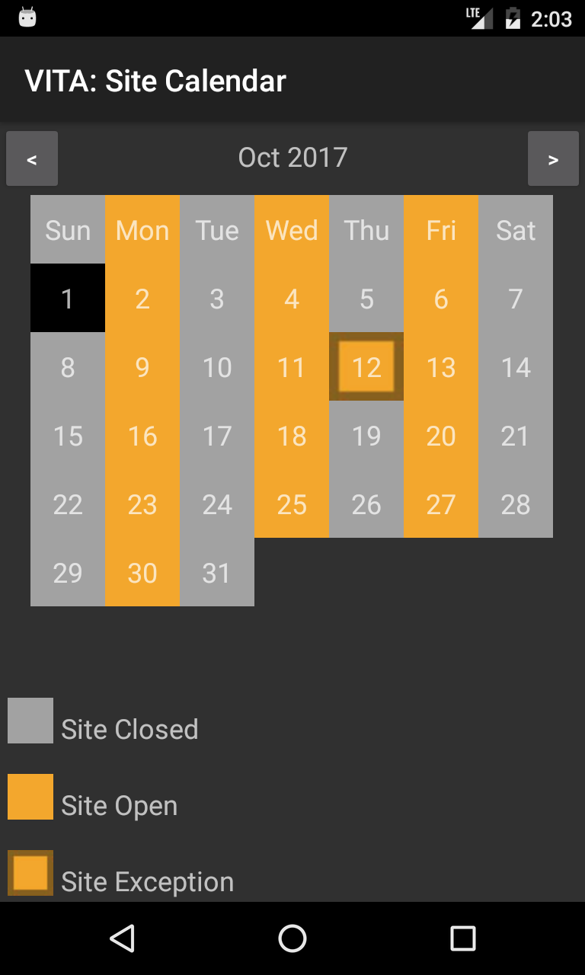

Slide 39
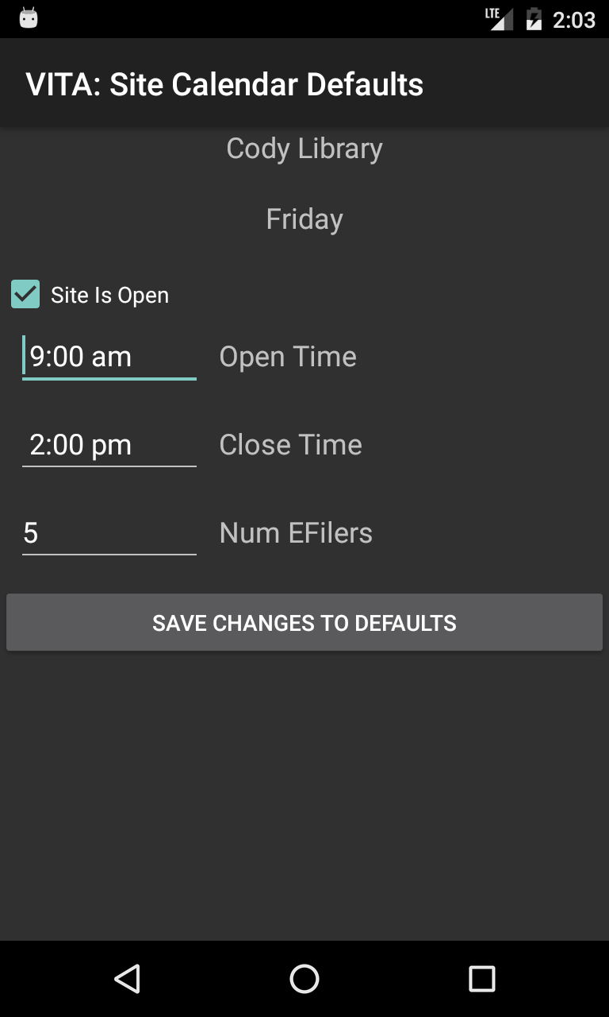

Slide 40
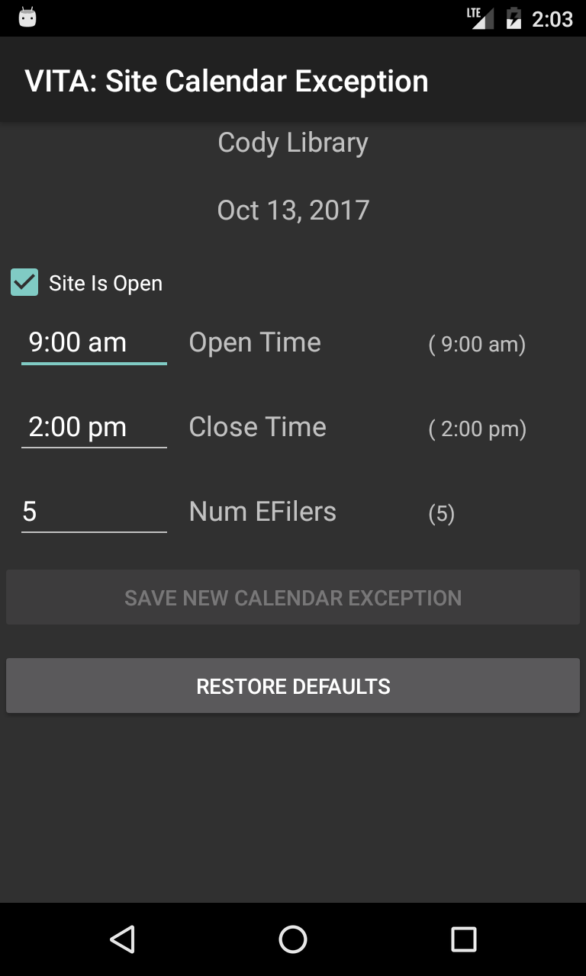

Slide 41
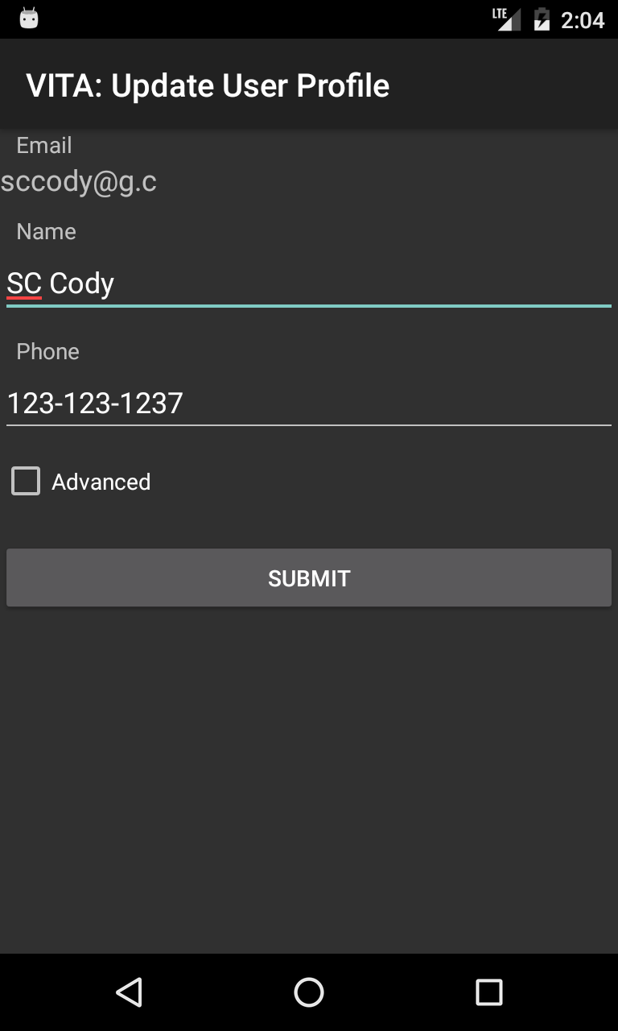

Slide 42


Slide 43
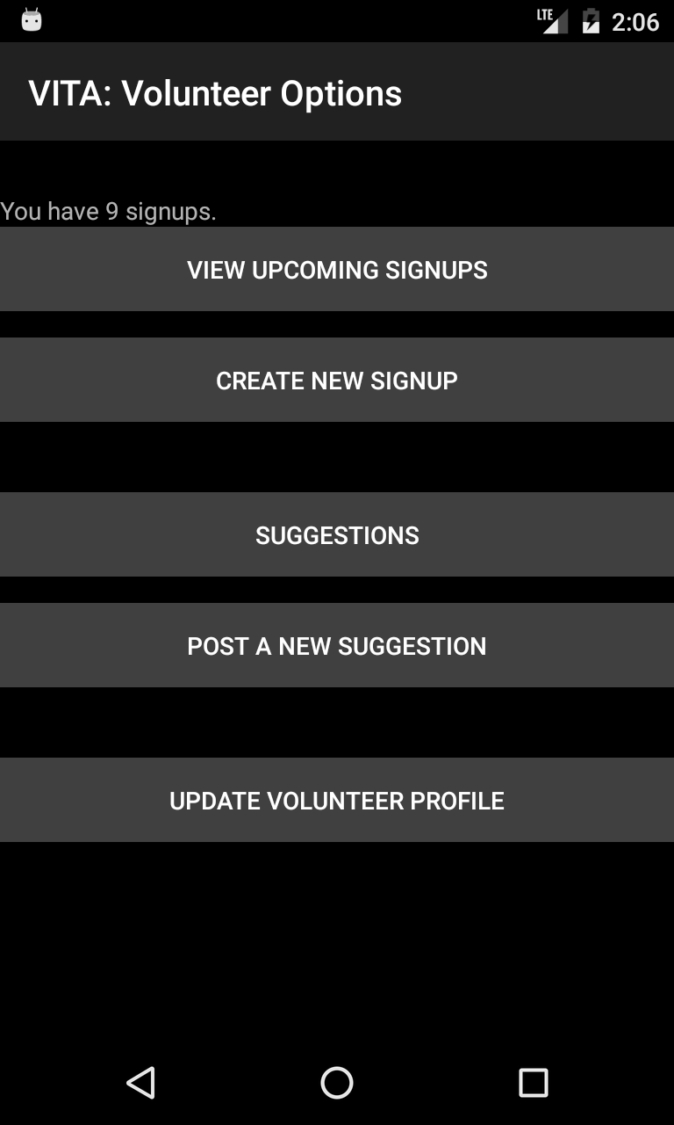

Slide 44
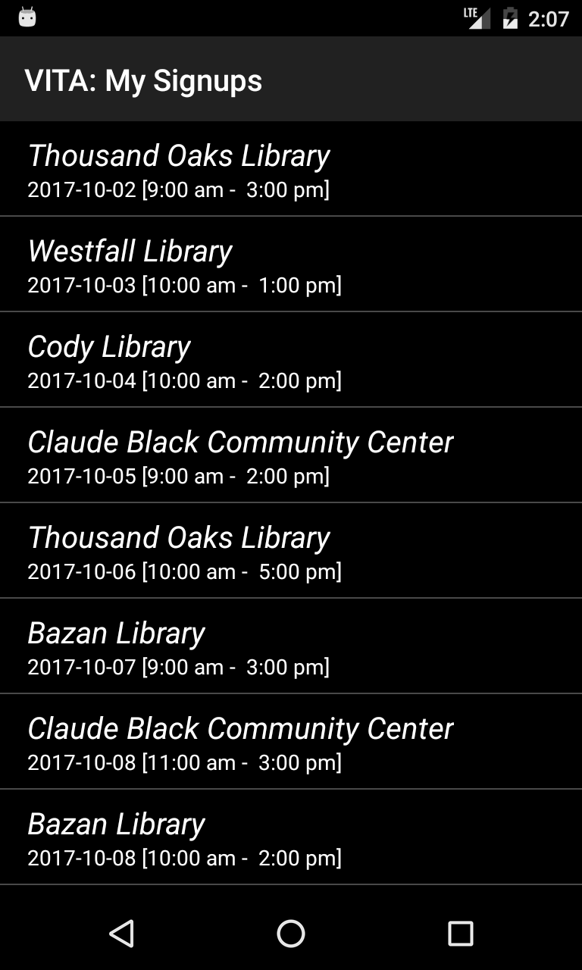

Slide 45
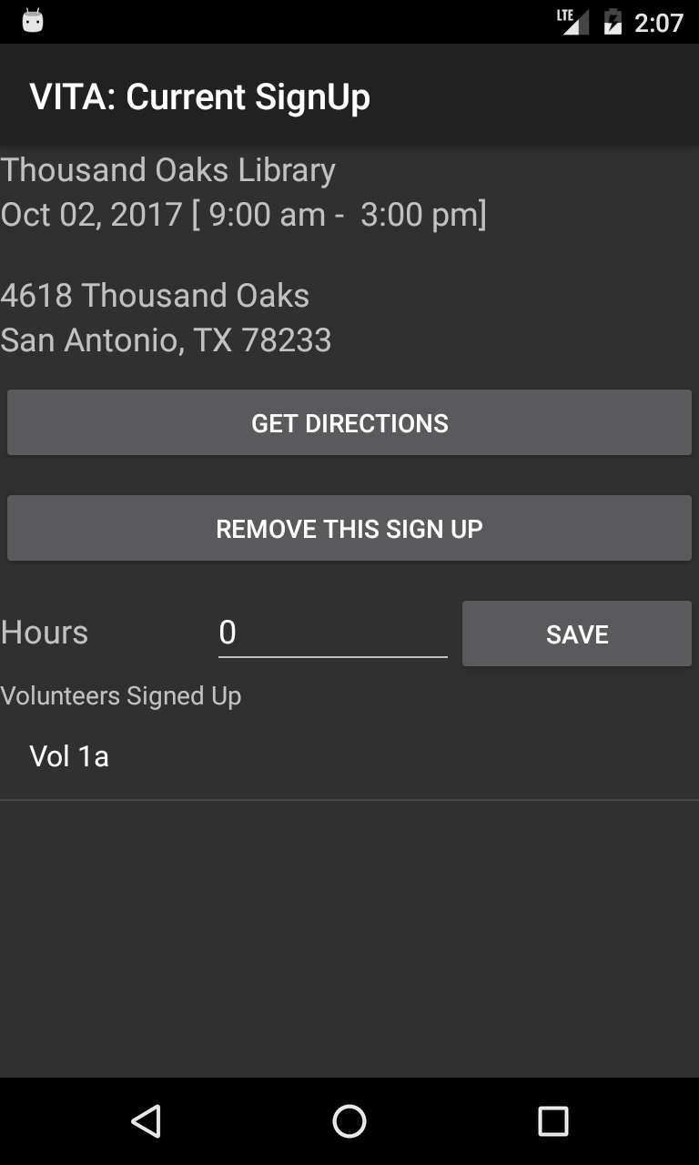

Slide 46
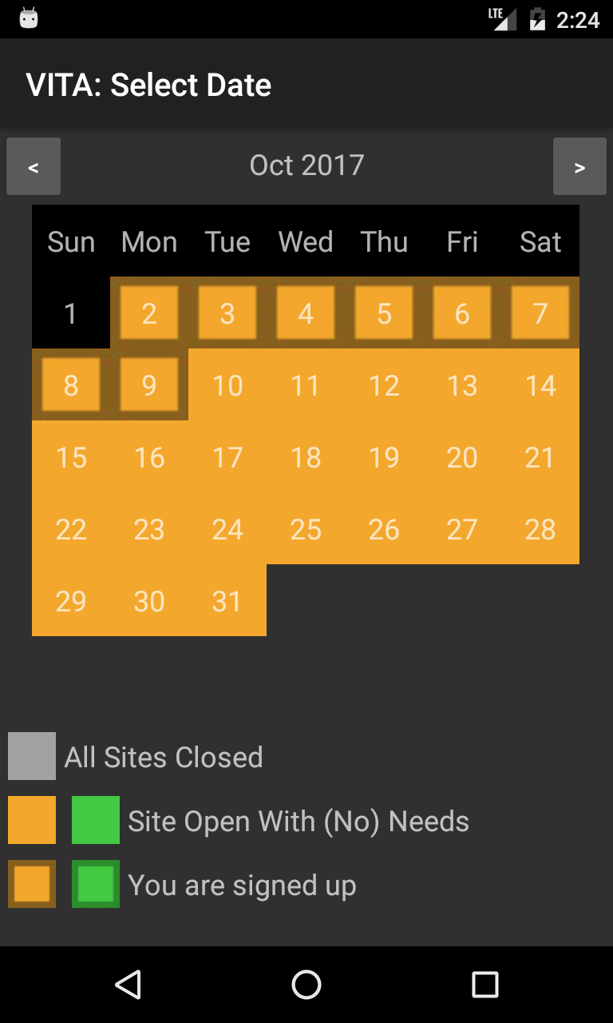

Slide 47
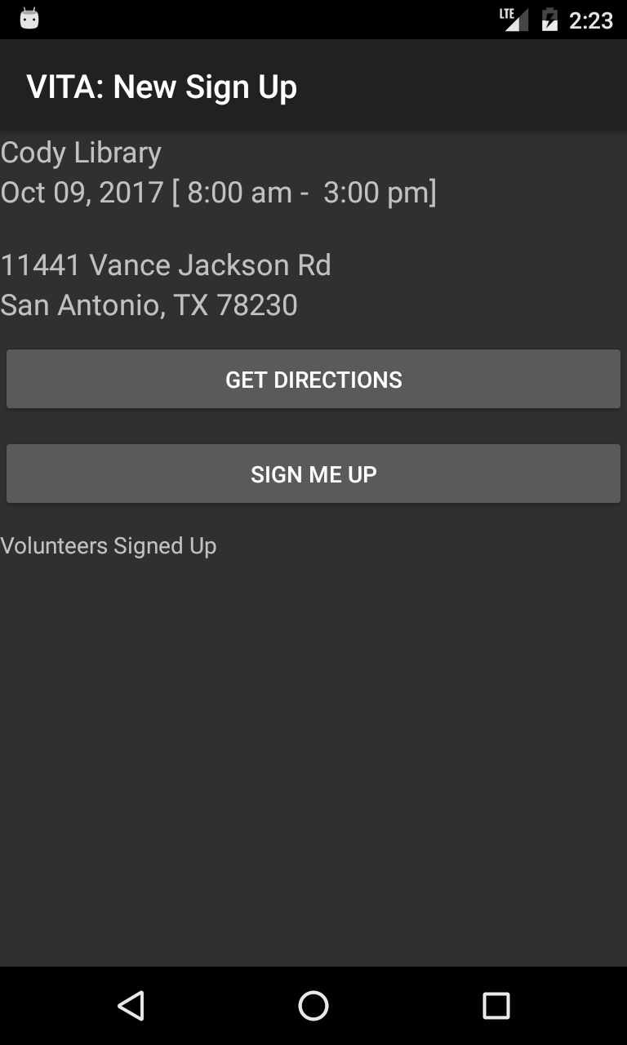

Slide 48
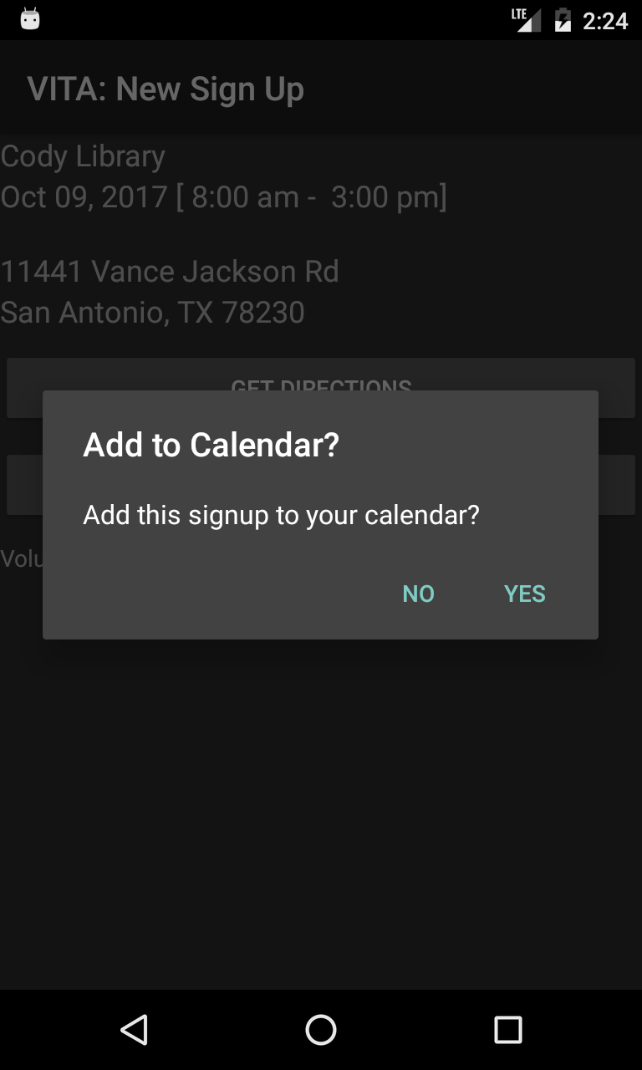

Slide 49
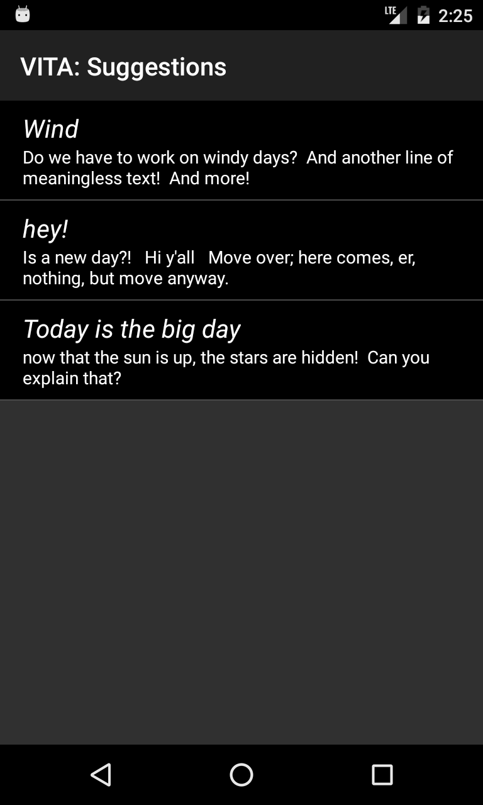

Slide 50
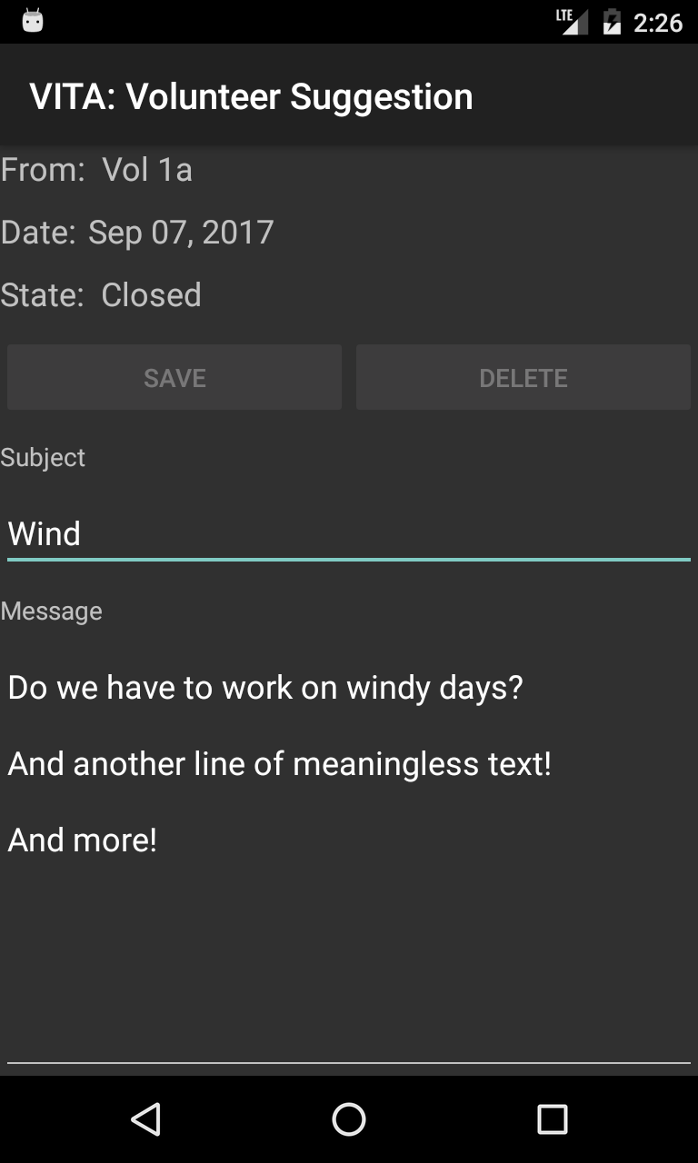

Slide 51
